Slide 1
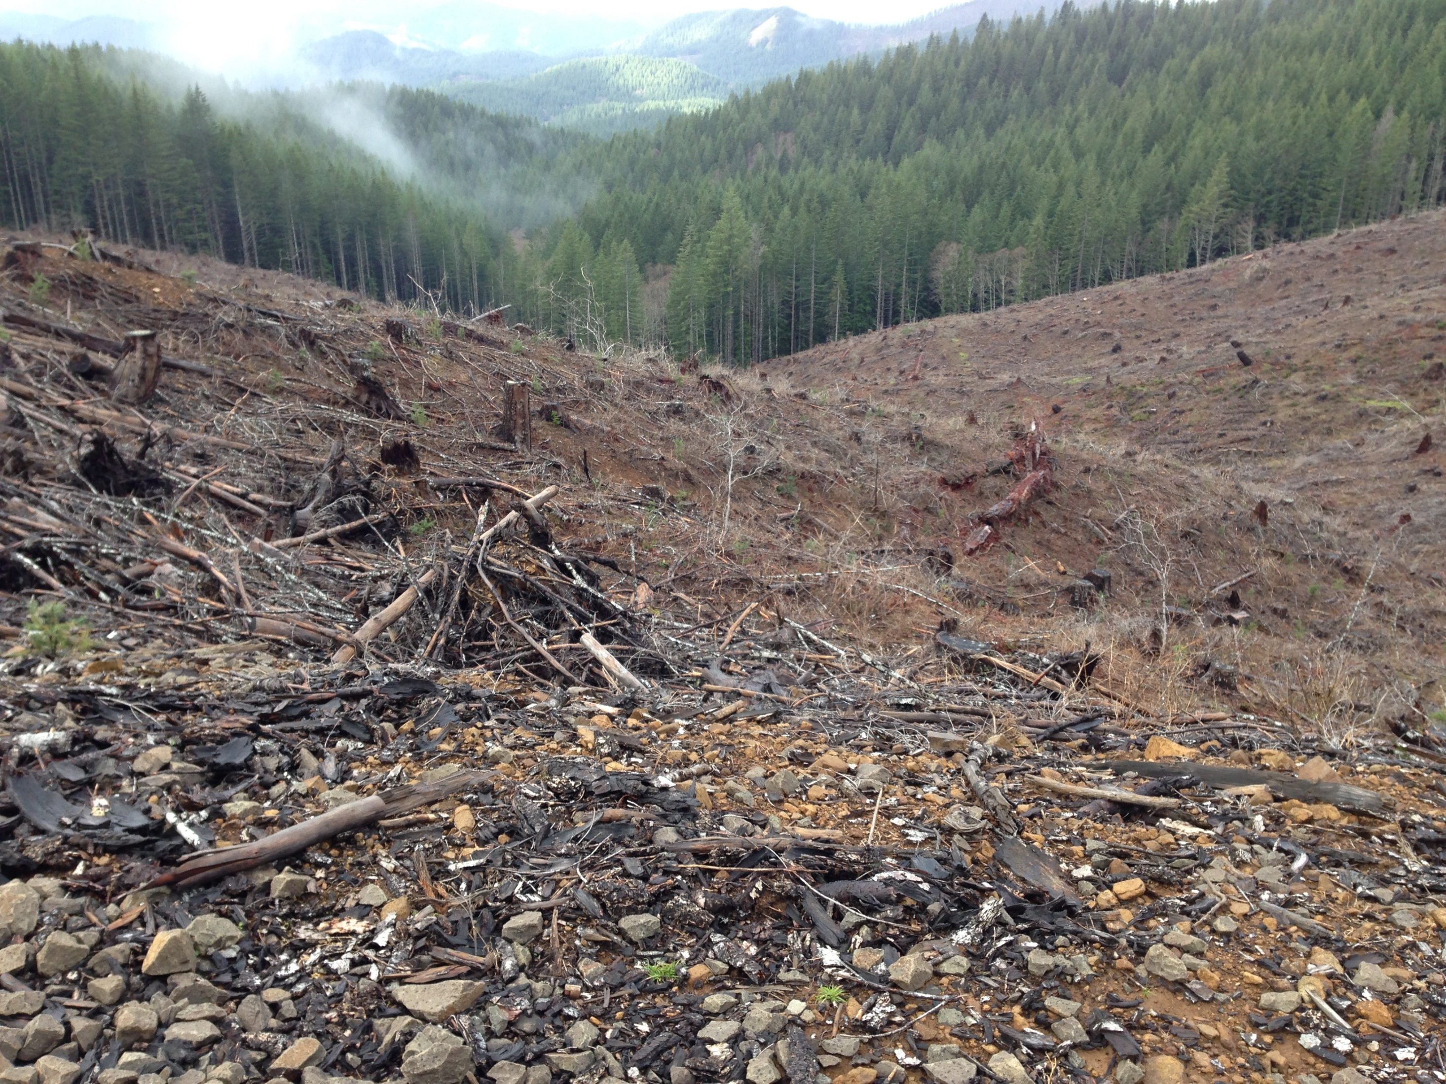
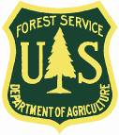
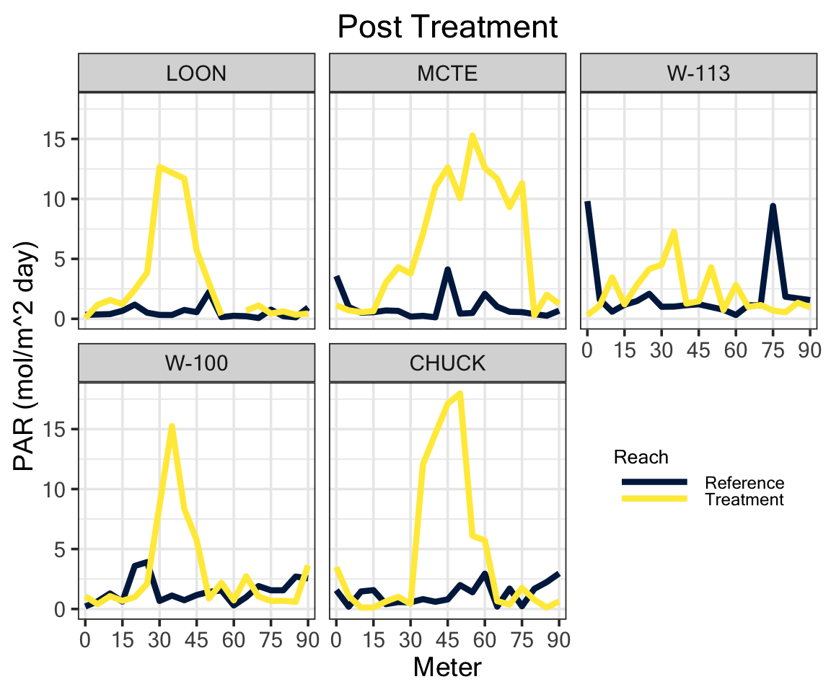
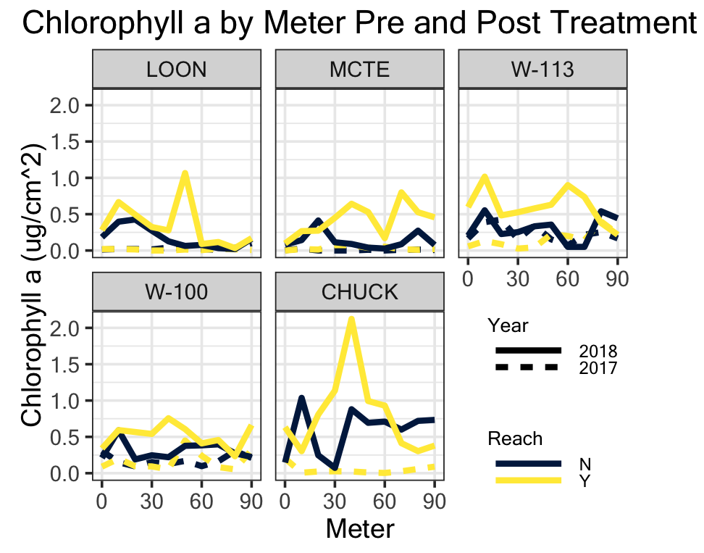
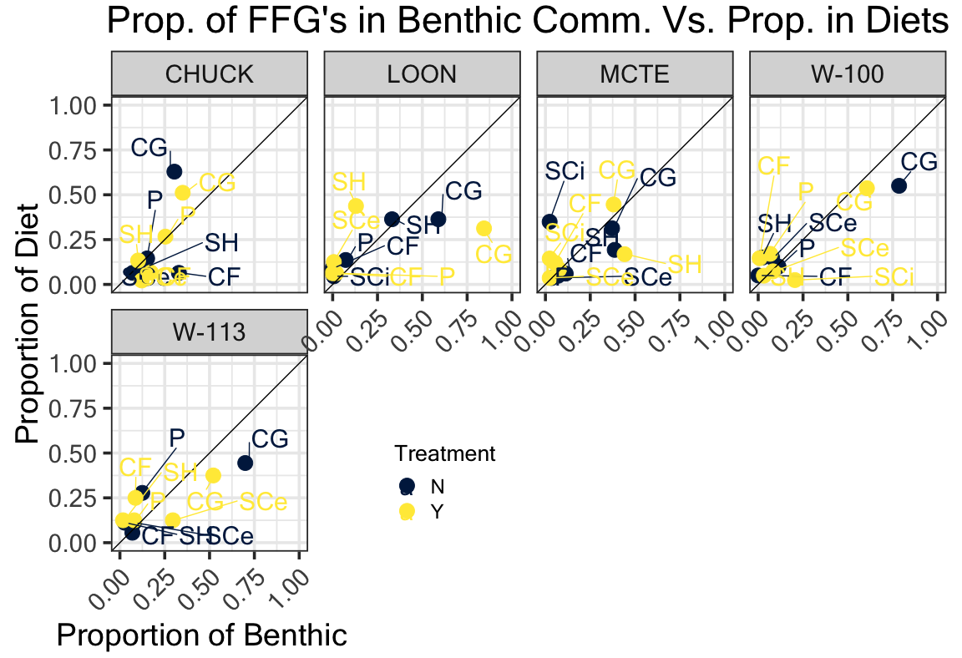
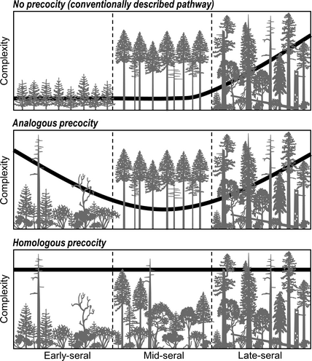
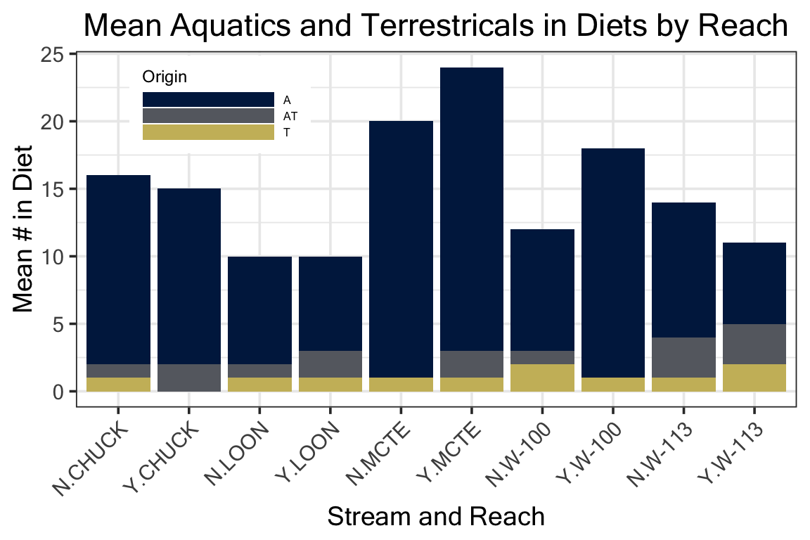
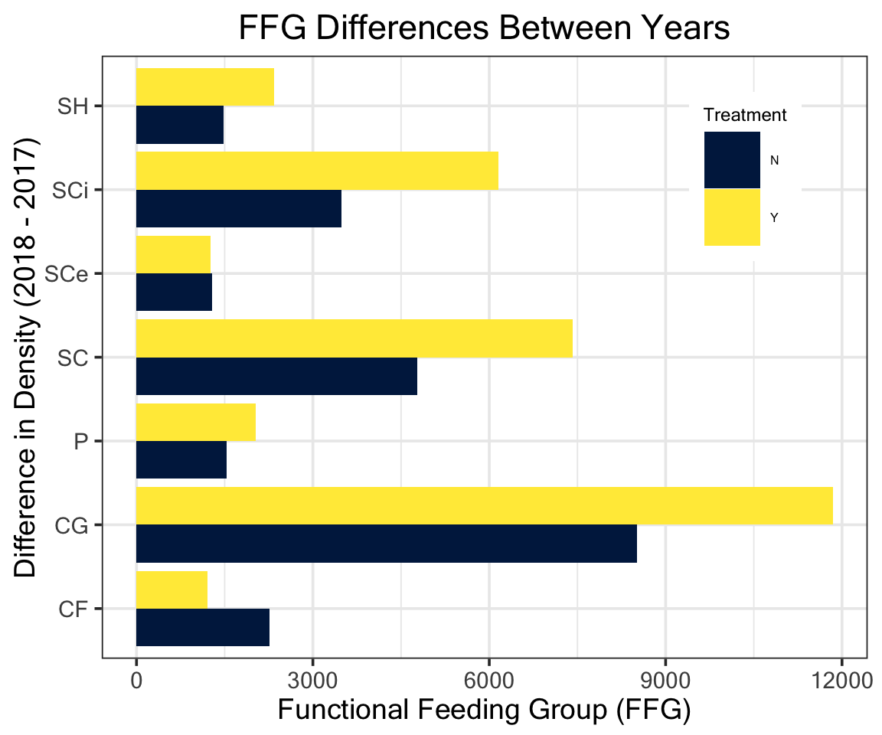
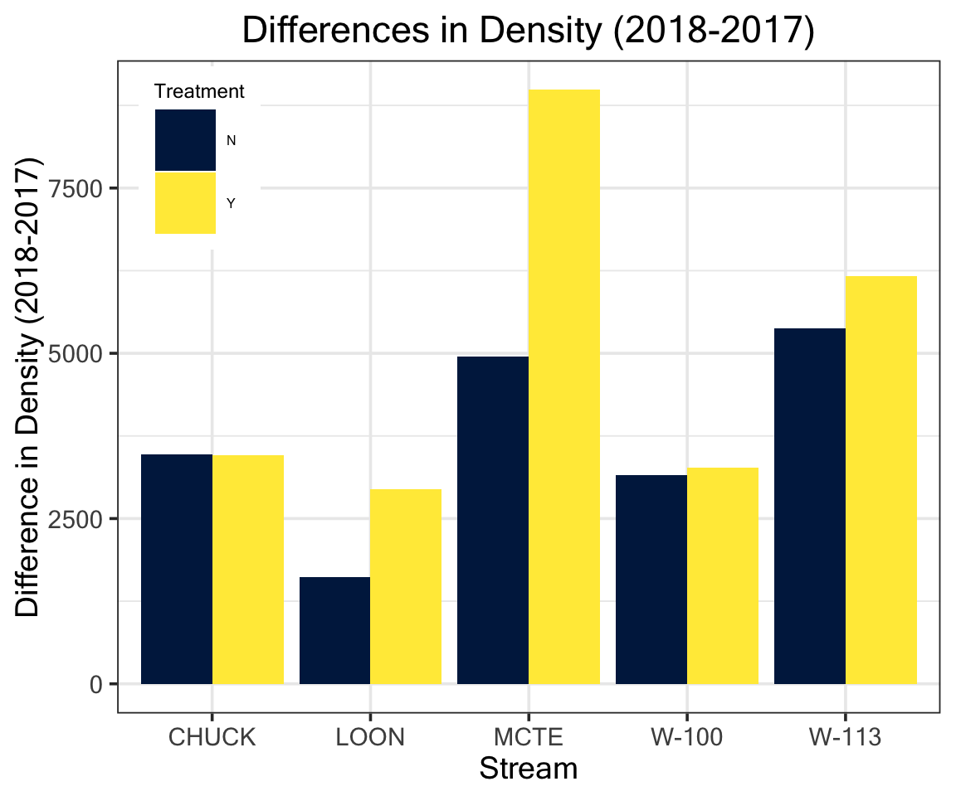
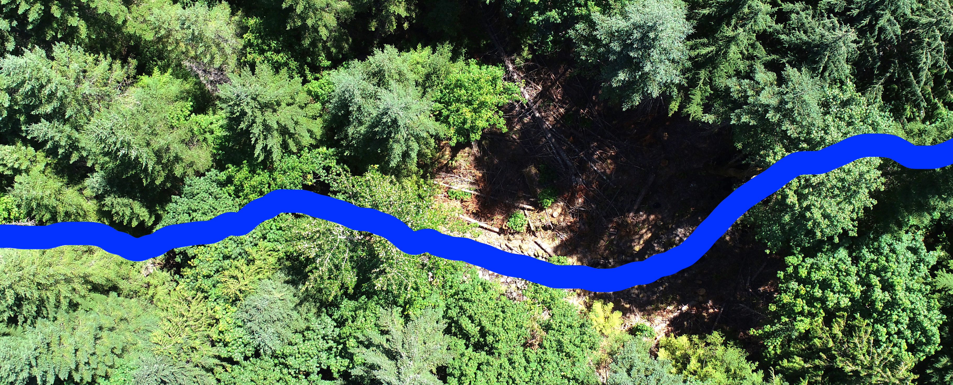
Effects of Light on Trout Diets and Macroinvertebrate
Community Assemblage
Cedar Mackaness^{1*}, Allison Swartz², Dave Roon & Dana R. Warren²
¹College of Earth, Ocean & Atmospheric Sciences - Oregon State University 2, Department of Forests Ecosystems and Society - Oregon State University
*corresponding author: mackanec@oregonstate.edu
Background
Riparian forests in the PNW have been heavily harvested, leaving dense, second growth vegetation that shades out streams. As these forests undergo stand development, tree mortality and natural disturbances will increase canopy heterogeneity and light availability.
Under current conditions we would expect: dense canopies → light limited GPP → low abundance of herbivorous invertebrates.
Results – PAR and Chlorophyll
Results – Diets
Figure 4.
PAR measured in the post-treatment year for both reaches.
PAR is higher in the gap meters of the treatment reach
Figure 5.
Total Chlorophyll in treated (Y) and control (N) reaches for 2017 and 2018.
Chla is higher in the treatment reach only in the post-treatment year,
Also marginally higher in the post-treatment year in the control reach
Figure 9.
A 1:1 plot of FFG rel. abundance in trout diets vs. benthic samples
Different relationships for each stream
No consistent relationship with treatment
Figure 1. Illustration showing second growth forests with closed canopies, and old-growth/mature stands with canopy gaps allowing light to reach the stream benthos.
Results – Invertebrates
Figure 10.
Mean number of invertebrates in trout diets for each stream reach, colored by their origin
Terrestrials are a relatively small proportion of diets
No consistent response in the treatment reaches
Study Questions
How do riparian forest canopy gaps affect local stream invertebrate communities?
Are any changes in the invertebrate community manifested in fish diets?
Hypothesis: Canopy gaps increase light availability which increases the abundance of grazing invertebrates, and these changes are reflected in fish diets.
Conclusions
Light and primary productivity increased in the gaps as expected.
Invertebrates showed a limited response to the treatment, but…
Most distinguishable response is among Scraper taxa, possibly in response to increases in autochthonous productivity
Trout diets have a variable response across streams, but there is no relationship with treatment and proportional representation of FFG’s in diets versus the benthic community
Methods
BACI study design across 5 reach pairs over 2 years. A canopy gap (~30 m. diameter) was cut in the treatment reach in between sampling years.
Benthic samples were taken with a Surber Sampler and diets were collected via gastrolavage.
Benthic samples were ID’ed to LTU, diets were ID’ed to the family level.
Analyses were performed in R using the Vegan package
Figure 6.
NMS plot of reaches in species space.
Strong year effect along Axis 1 (years tend to fall out in separate groups)
Axis 1 also has a strong positive relationship with Chla (r² = .302)
Relationship with Chla not necessarily due to the treatment (Chla higher in both reaches in the post-treatment year)
Figure 7.
Functional Feeding Group differences between years
Scrapers and Collector-Gatherers see the largest increases
Figure 8.
Differences between years in total invertebrate density.
No reach went down in 2018, MCTE treatment went up most
Acknowledgements:
HJ Andrews Experimental Forest, Greg Downing, Jay Sexton, Mark Schultz, Maryanne Reiter, Alvaro Cortes, Matt Kaylor, Nate Day, Corey Culp , Matt McDonald
Figure 2. Aerial view of the gap at CHUCK
Figure 3. Study area in western Cascade mountains of Oregon

